Slide 1







ABC Bank

Slide 2



The Ask where we started

Slide 3
Agenda
Objective of the Training
Framework for 8 Weeks
Overview
Our Journey
Bank Application
Full stack Architecture
Tools Used

Slide 4
Overview of Bank Application
Problem definition
Challenges and solution
Scope and conclusion
Our Team
Screenshots
Questions
Demo

Slide 5

Objective of the Training
Become a Full Stack developer by gaining all the skills required to work with front-end and back-end technologies.

Slide 6

Framework for 8 Weeks
1
Database Concepts and SQL
Introduction to Applications
2
Object Oriented Programming
Data Structures Core Java Programming
3
Project- Banking Application
JDBC and Web Design fundamentals
4
Html, CSS,
Bootstrap, AJAX
5
Java Script, ES5, ES6, Angular7
UML Diagrams
6
Architecture, framework of angular.
JEE Architecture
40 Days- 280 Hours of Training
7
JSP Servlet
Spring REST( Core & MVC)
8
Project Presentation

Slide 7
Overview
DBMS
OOPs
Java script
Jsp and Servlet
HTML and CSS
Angular7
Structured Query Language
Spring Rest
Jenkins

Slide 8

Our Journey

Slide 9
ABC Bank
Project-Banking Application
Low Level Diagrams- Use Case , Class, Application Flow.
Data Base Schema Design
Architecture of Banking Application.
UI Structure using Angular7( HTML/CSS/JS).
Backend Structure using JAVA, Spring Rest, Database
Build and test project using Jenkins.

Slide 10
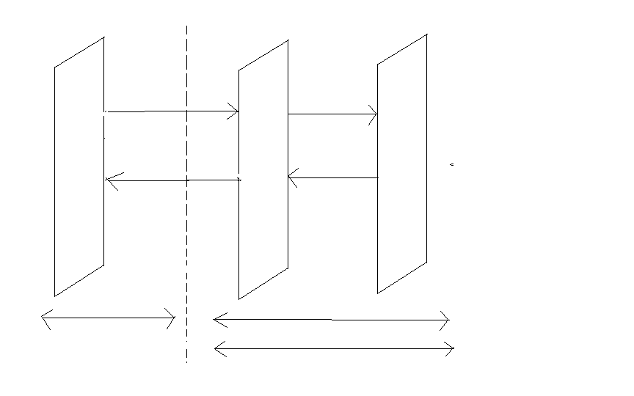
Full Stack Architecture
Angular7
HTML/CSS/JS
Java/Spring
Hibernate
Xml HTTP Request
Browser
ORM/Database
DB
UI/UX
BC(Spring Boot)
Xml HTTP Response
Node JS
REST API
Node JS
Tomcat /Jetty
Front End Development

Slide 11











FRONTEND
BACKEND
DevOps
DATA

Slide 12
Overview of ABC Bank Management Application
These are the various job positions within Bank System. The positions are as follows:
Superuser
Admin
Agent
Customer

Slide 13
ABC Bank Management Application
ABC Bank Application allows us to perform all banking related CRUD operations.
Our use case deals with all agent operations.

Slide 14
Problem Definition
To view the customer details ,view transactions of the customer, view update and delete agent profile and approve customer.

Slide 15


Slide 16
Scope and Conclusion
Scope
This project can be implemented in any bank for fulfilling the basic need
Conclusion
The agent can activate and deactivate customer account and can view customers of his own branch and can view transaction details

Slide 17
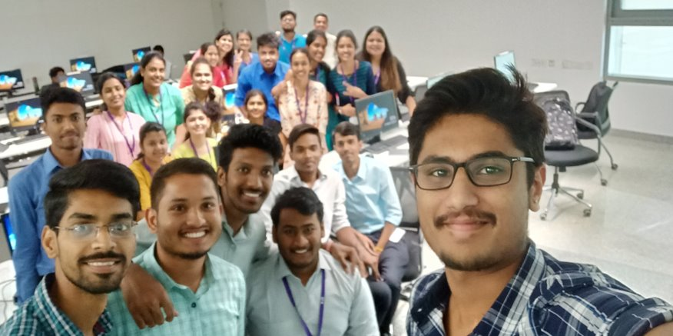
Our Team

Slide 18

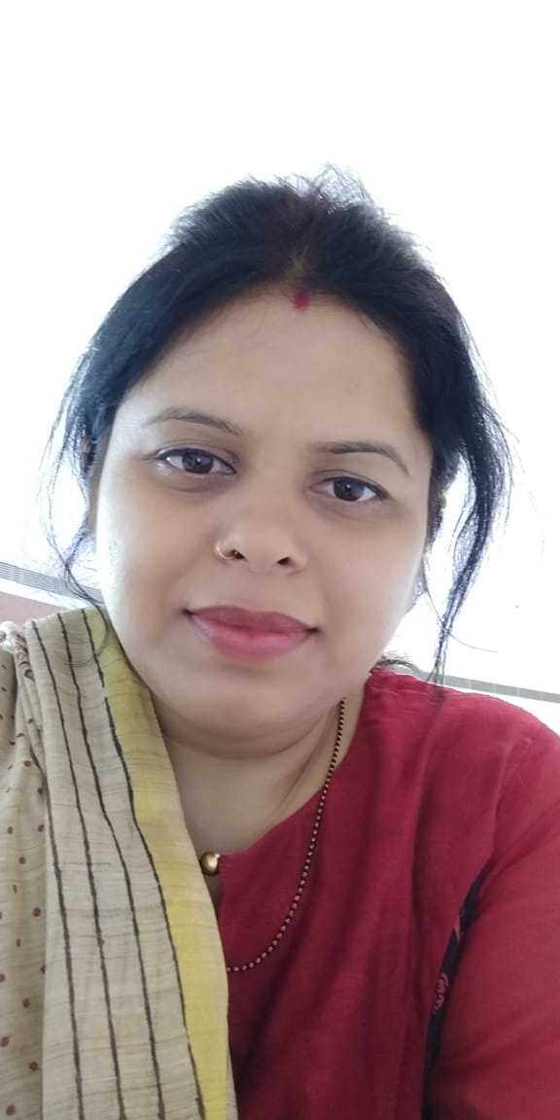



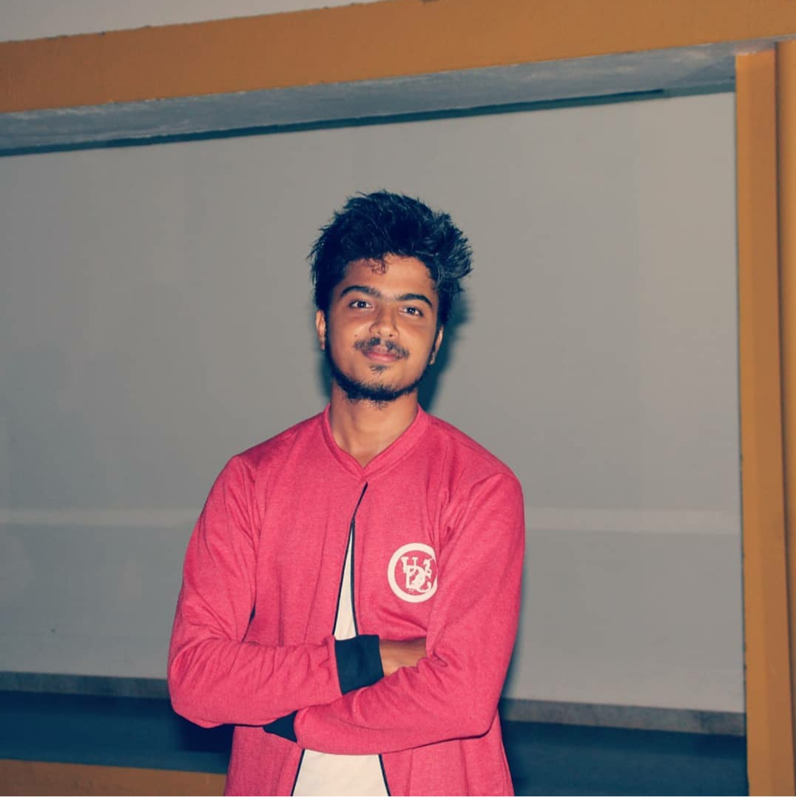
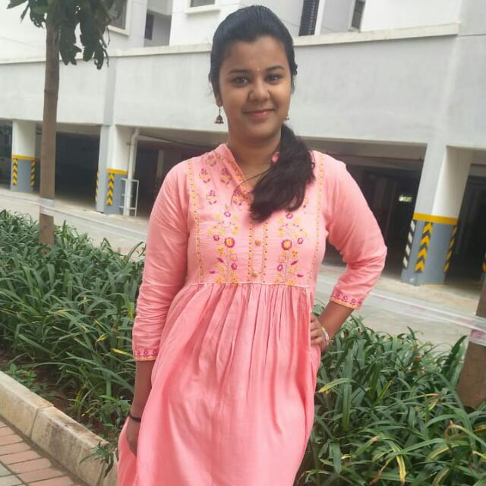

Team Sapphire
Trainers
Upasana
Kavita Gupta
Amit Balyan
Vikas B
Nikitha Shetty
Shravan Kini
Soumya Jakati
Rachana Bhandary

Slide 19
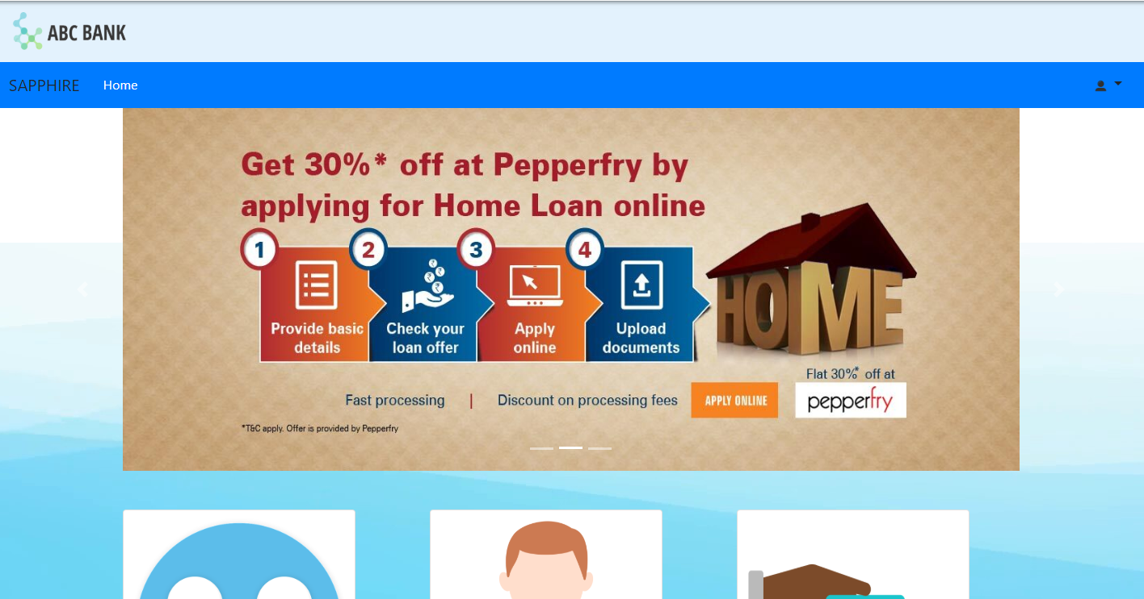
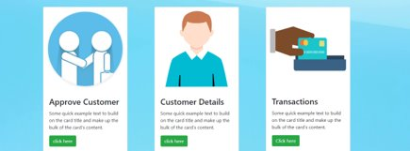
Agent Page Screenshot

Slide 20


Slide 21


